Slide 1
Wind Turbines
By Charity Fischer

Slide 2
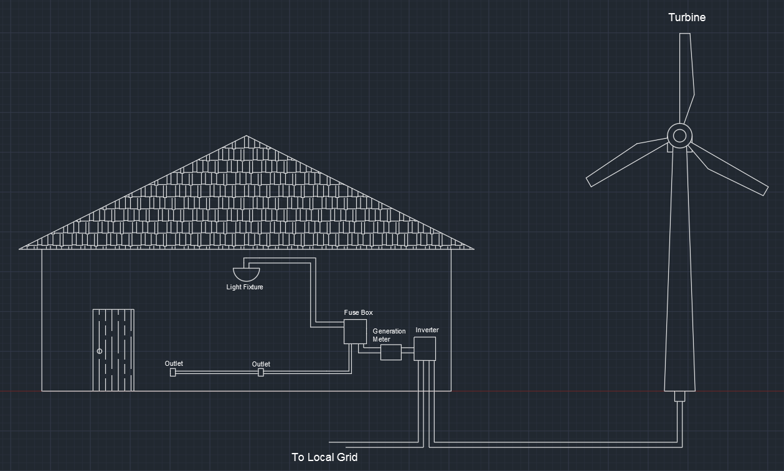
Home Wind Turbine

Slide 3
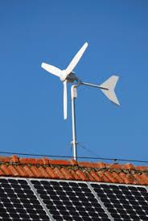
Home Wind Turbine
400 Watts - 100 Kilowatts
$48,000 - $65,000
80 - 140 ft Tall
Investment Made Back in 6 - 30 years

Slide 4
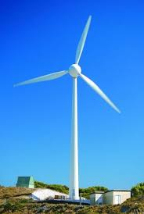
Pros and Cons
Low-Cost Energy
Green Energy
Sustainable
Protects From Power Outages
Domestic

Slide 5
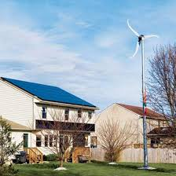
Pros and Cons
Cost of Installation
Loud Noise
Bad Aesthetic
Unreliable Winds

Slide 6
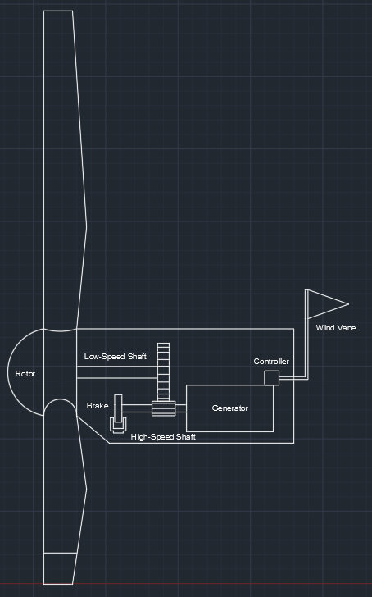
How It Works
Rotor
Low-Speed Shaft
High-Speed Shaft
Brake
Generator
Controller
Wind Vane

Slide 7
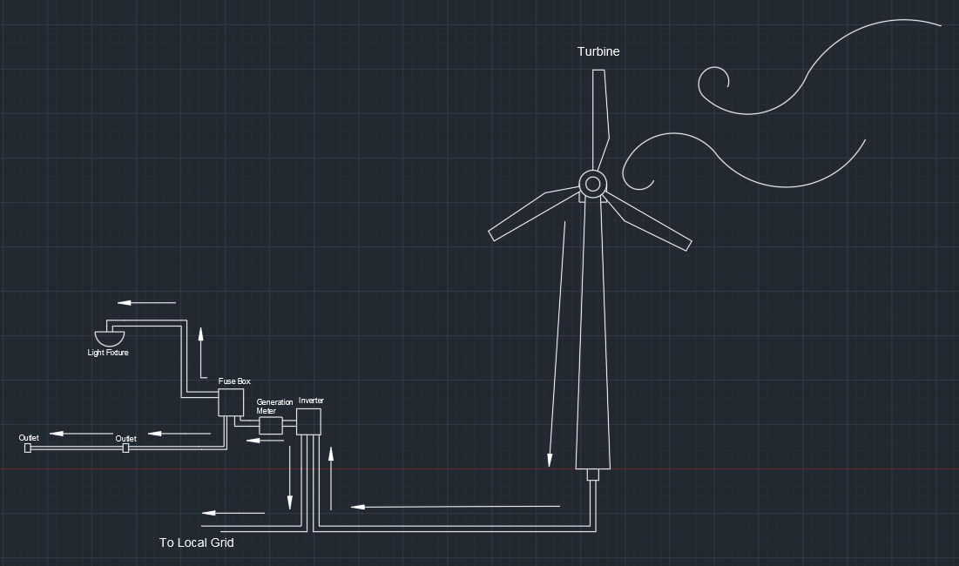
How It Works

Slide 8
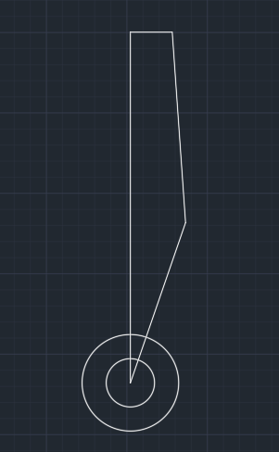
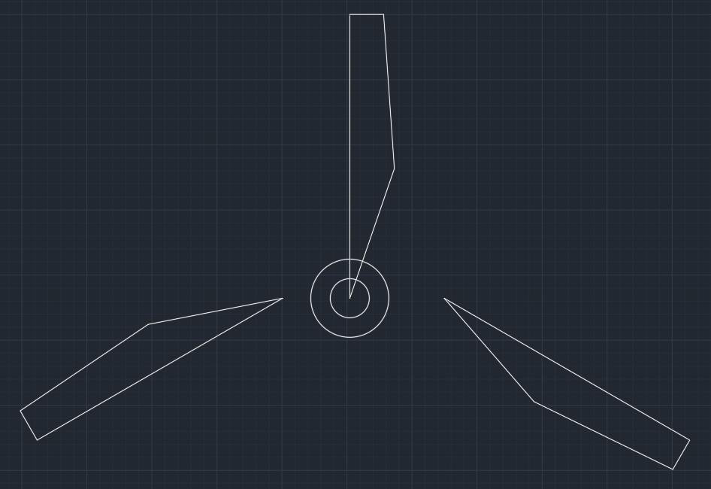
How It Was Made In AutoCAD

Slide 9
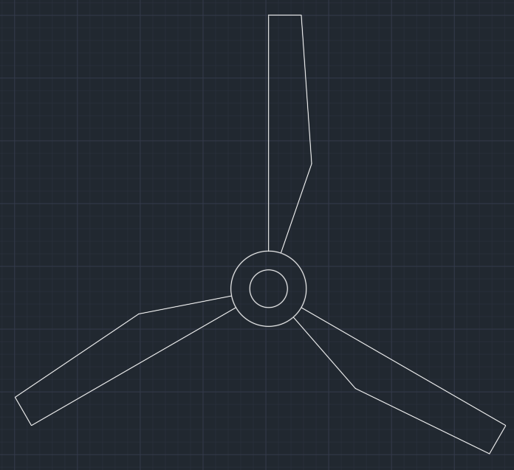
How It Was Made In AutoCAD

Slide 10
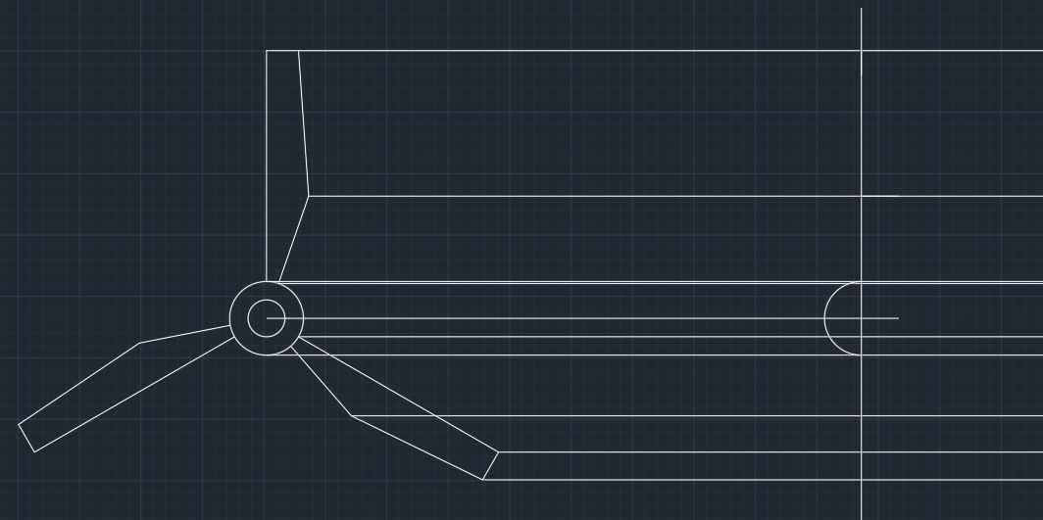
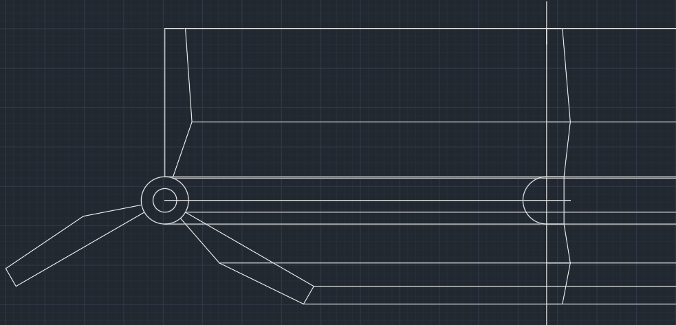
How It Was Made In AutoCAD

Slide 11
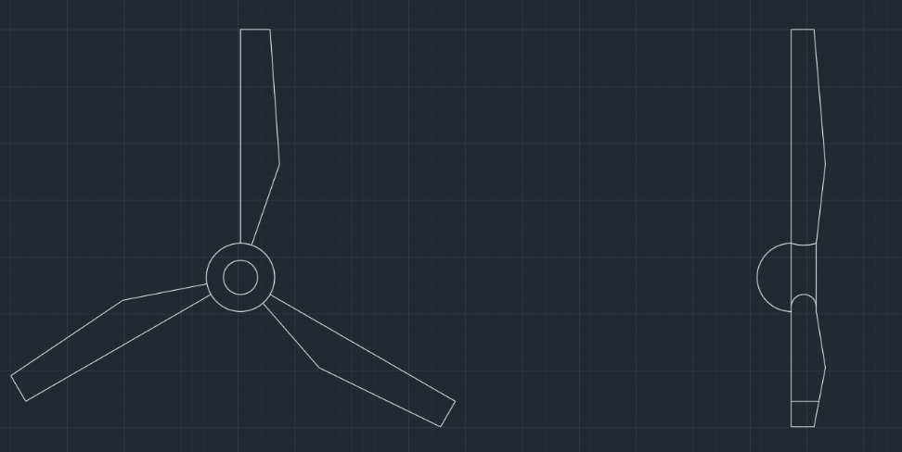
How It Was Made In AutoCAD

Slide 12
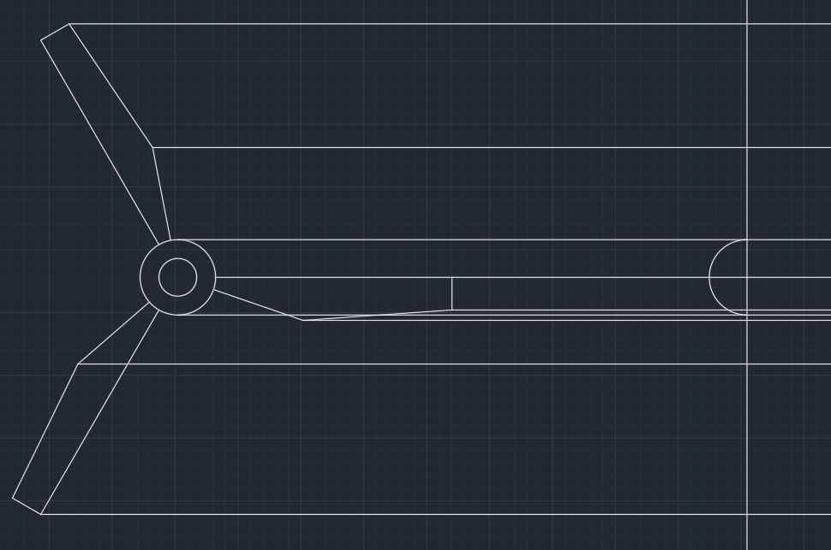
How It Was Made In AutoCAD

Slide 13
References
https://energy.gov/eere/wind/advantages-and-challenges-wind-energy
John Kingsley, iFluids Engineering
https://windexchange.energy.gov/small-wind-guidebook#parts
http://bergey.com/wind-school/residential-wind-energy-systems
http://www.windpowerengineering.com/construction/size-wind-turbine-need/

